Slide 1
Database Fundamentals
CE2103 - Algorithms and Data Structures II

Slide 2
Disclaimer / Descargo de Responsabilidad
Esta presentación corresponde a una guía usada por el profesor durante las clases. La misma ha sido modificada para ser utilizado en el modelo de cursos asistidos por tecnología. No es una versión final, por lo que la misma podría requerir todavía hacer algunos ajustes. Para aspectos de evaluación esta presentación es solo una guía, por lo que el estudiante debe profundizar con el material de lectura asignado y lo discutido en clases para aspectos de evaluación.
This presentation corresponds to a guide material used by the professor during classes. It has been modified to be used in the model of technology-assisted courses. It is not a final version, so it may still require some adjustments. For evaluation aspects, this presentation is only a guide, so the student should delve with the assigned reading material and what has been discussed in class.

Slide 3
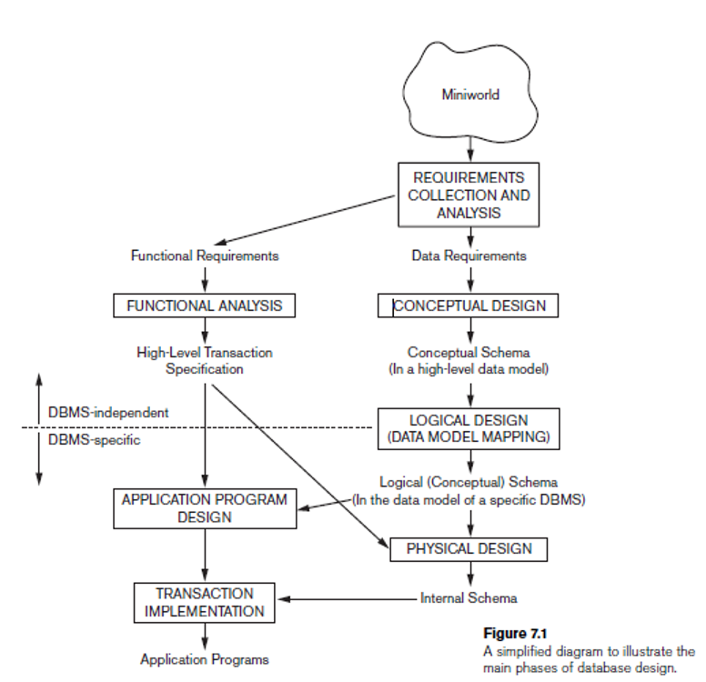
Database Design Process

Slide 4
Introduction
Database refers to a set of related data and the way it is organized.
A database is designed, built, and populated with data for a specific purpose. It has an intended group of users and some preconceived applications in which these users are interested.
Examples:
Bank to deposit or withdraw funds.
Hotel or airline reservation.
Access a computerized library catalog.
Purchase something online.

Slide 5
Types of Databases
Relational Databases
Object-Oriented Databases
Distributed Databases
NoSQL Databases
And other types

Slide 6
Types of Databases
Relational Databases
Object-Oriented Databases
Distributed Databases
NoSQL Databases
And other types
For now we are going to focus on this type of database

Slide 7
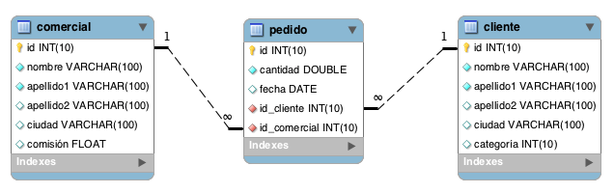
Relational Database
The elements of a relational database are organized as a set of tables with columns and rows.

Slide 8
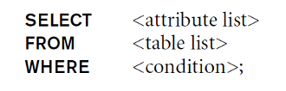
Sentencia SELECT
DESCRIPTION
SINTAXIS
Recover info from Database.

Slide 9

Sentencia INSERT
DESCRIPTION
SINTAXIS
Used to add rows in a table.

Slide 10
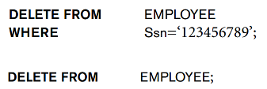
Sentencia DELETE
DESCRIPTION
SINTAXIS
Used to remove rows from a table.

Slide 11

Sentencia UPDATE
DESCRIPTION
SINTAXIS
Used to modify the information of the rows of a table.

Slide 12
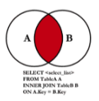
Sentencia INNER JOIN
DESCRIPTION
SINTAXIS
Join information from different tables with some attribute in common.

Slide 13
NoSQL Database
A NoSQL database, or non-relational database, allows you to store and manipulate unstructured and semi-structured data.
Unlike a relational database, which defines how all the data inserted into the database should be composed).

Slide 14
Database Fundamentals
CE2103 - Algorithms and Data Structures II

